Slide 1

FM Synthesis
HW3 Presentation – 31/05/21

Slide 2

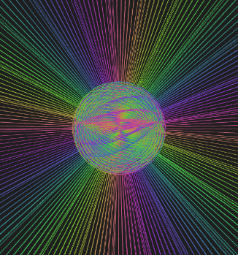
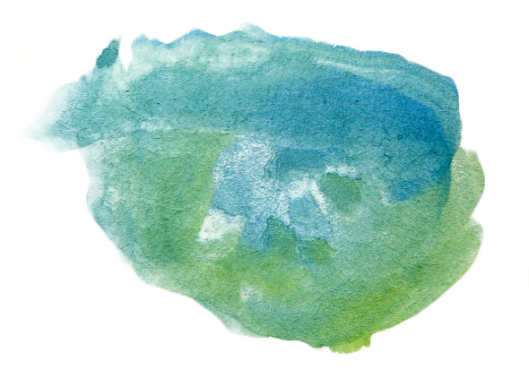
Hello!
We are group 2
And we are going to present our personal FM Synthetizer
You can find our code @ https://github.com/EllDy96/CarlGang/tree/Homework3

Slide 3
Introduction
SuperCollider implementation
Interaction design
Demo
Improvements roadmap
Index

Slide 4
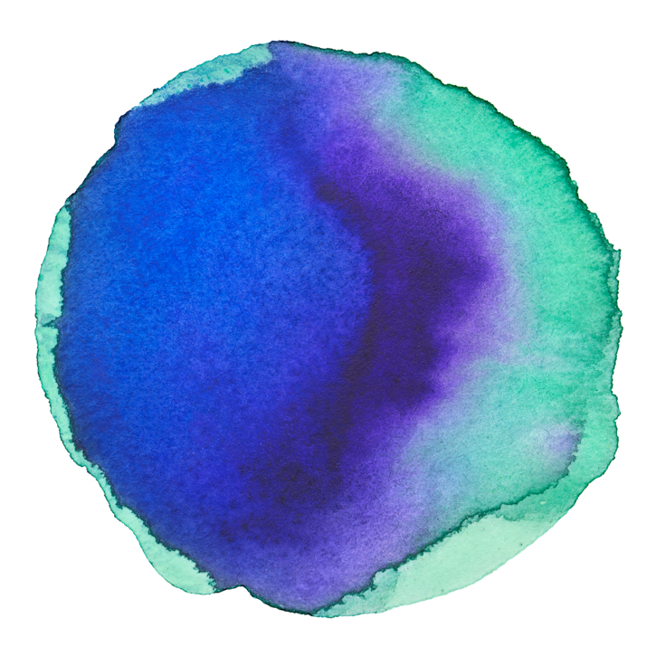
Assignment
Implement an instrument based on FM synthesis and an interface for controlling it.
1 Introduction
Implementation
Synthesis part: SuperCollider
Control part: ml5.js and p5.js frameworks

Slide 5

2 SuperCollider implementation
MIDI control & OSC messages

Slide 6



MIDI control
OSC messages
Monophonic Synth controlled by NoteOn and NoteOff functions
4 parameters:
X centroid
feedback
Y centroid
modulation amplitude
palm-index distance
LFO cut off
palm slope
reverb

Slide 7
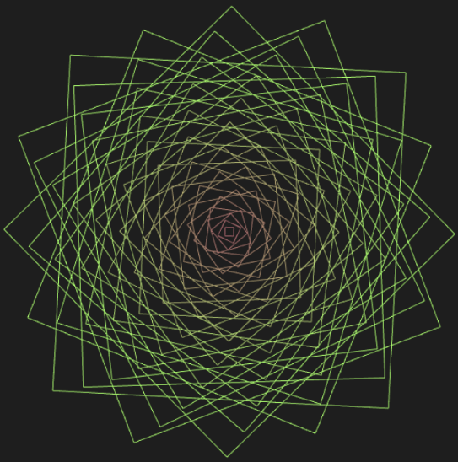
3 Interaction design
Using a pre-trained ML model from ml5.js and the p5.js framework for the animations implementation

Slide 8





Modules and libraries used

Slide 9
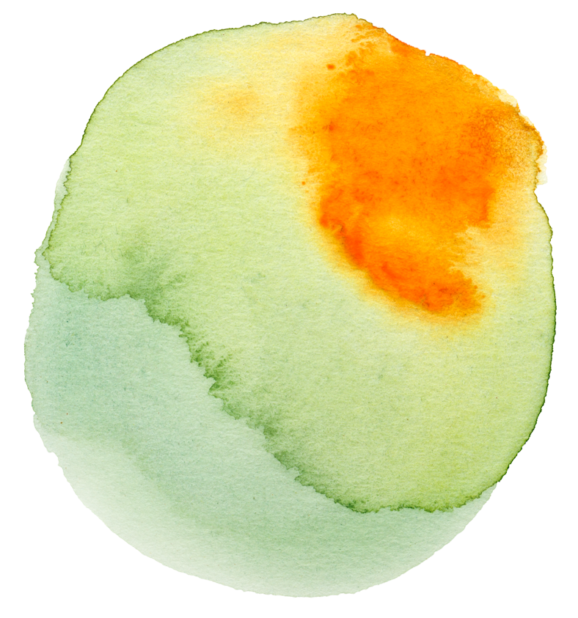
The three animations
Squared Rose
Sun Sphere
Double Square
It represents the variation of the reverb amount.
It represents the double variation of feedback (sphere radius) and modulation amplitude (rays length).
Used for describing the variation of the LFO cut off.

Slide 10

4 Time for the DEMO

Slide 11

5 Improvements roadmap
Polyphonic
Synth
Amazing
Read.me
More Synths

Slide 12

Funny facts
50000+ hours
130%
Everyone
Spent for parameters tuning
Better than our previous presentations
Will love this synthetizer

Slide 13
The End…
Thanks for your attention

